Slide 1
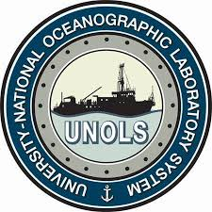
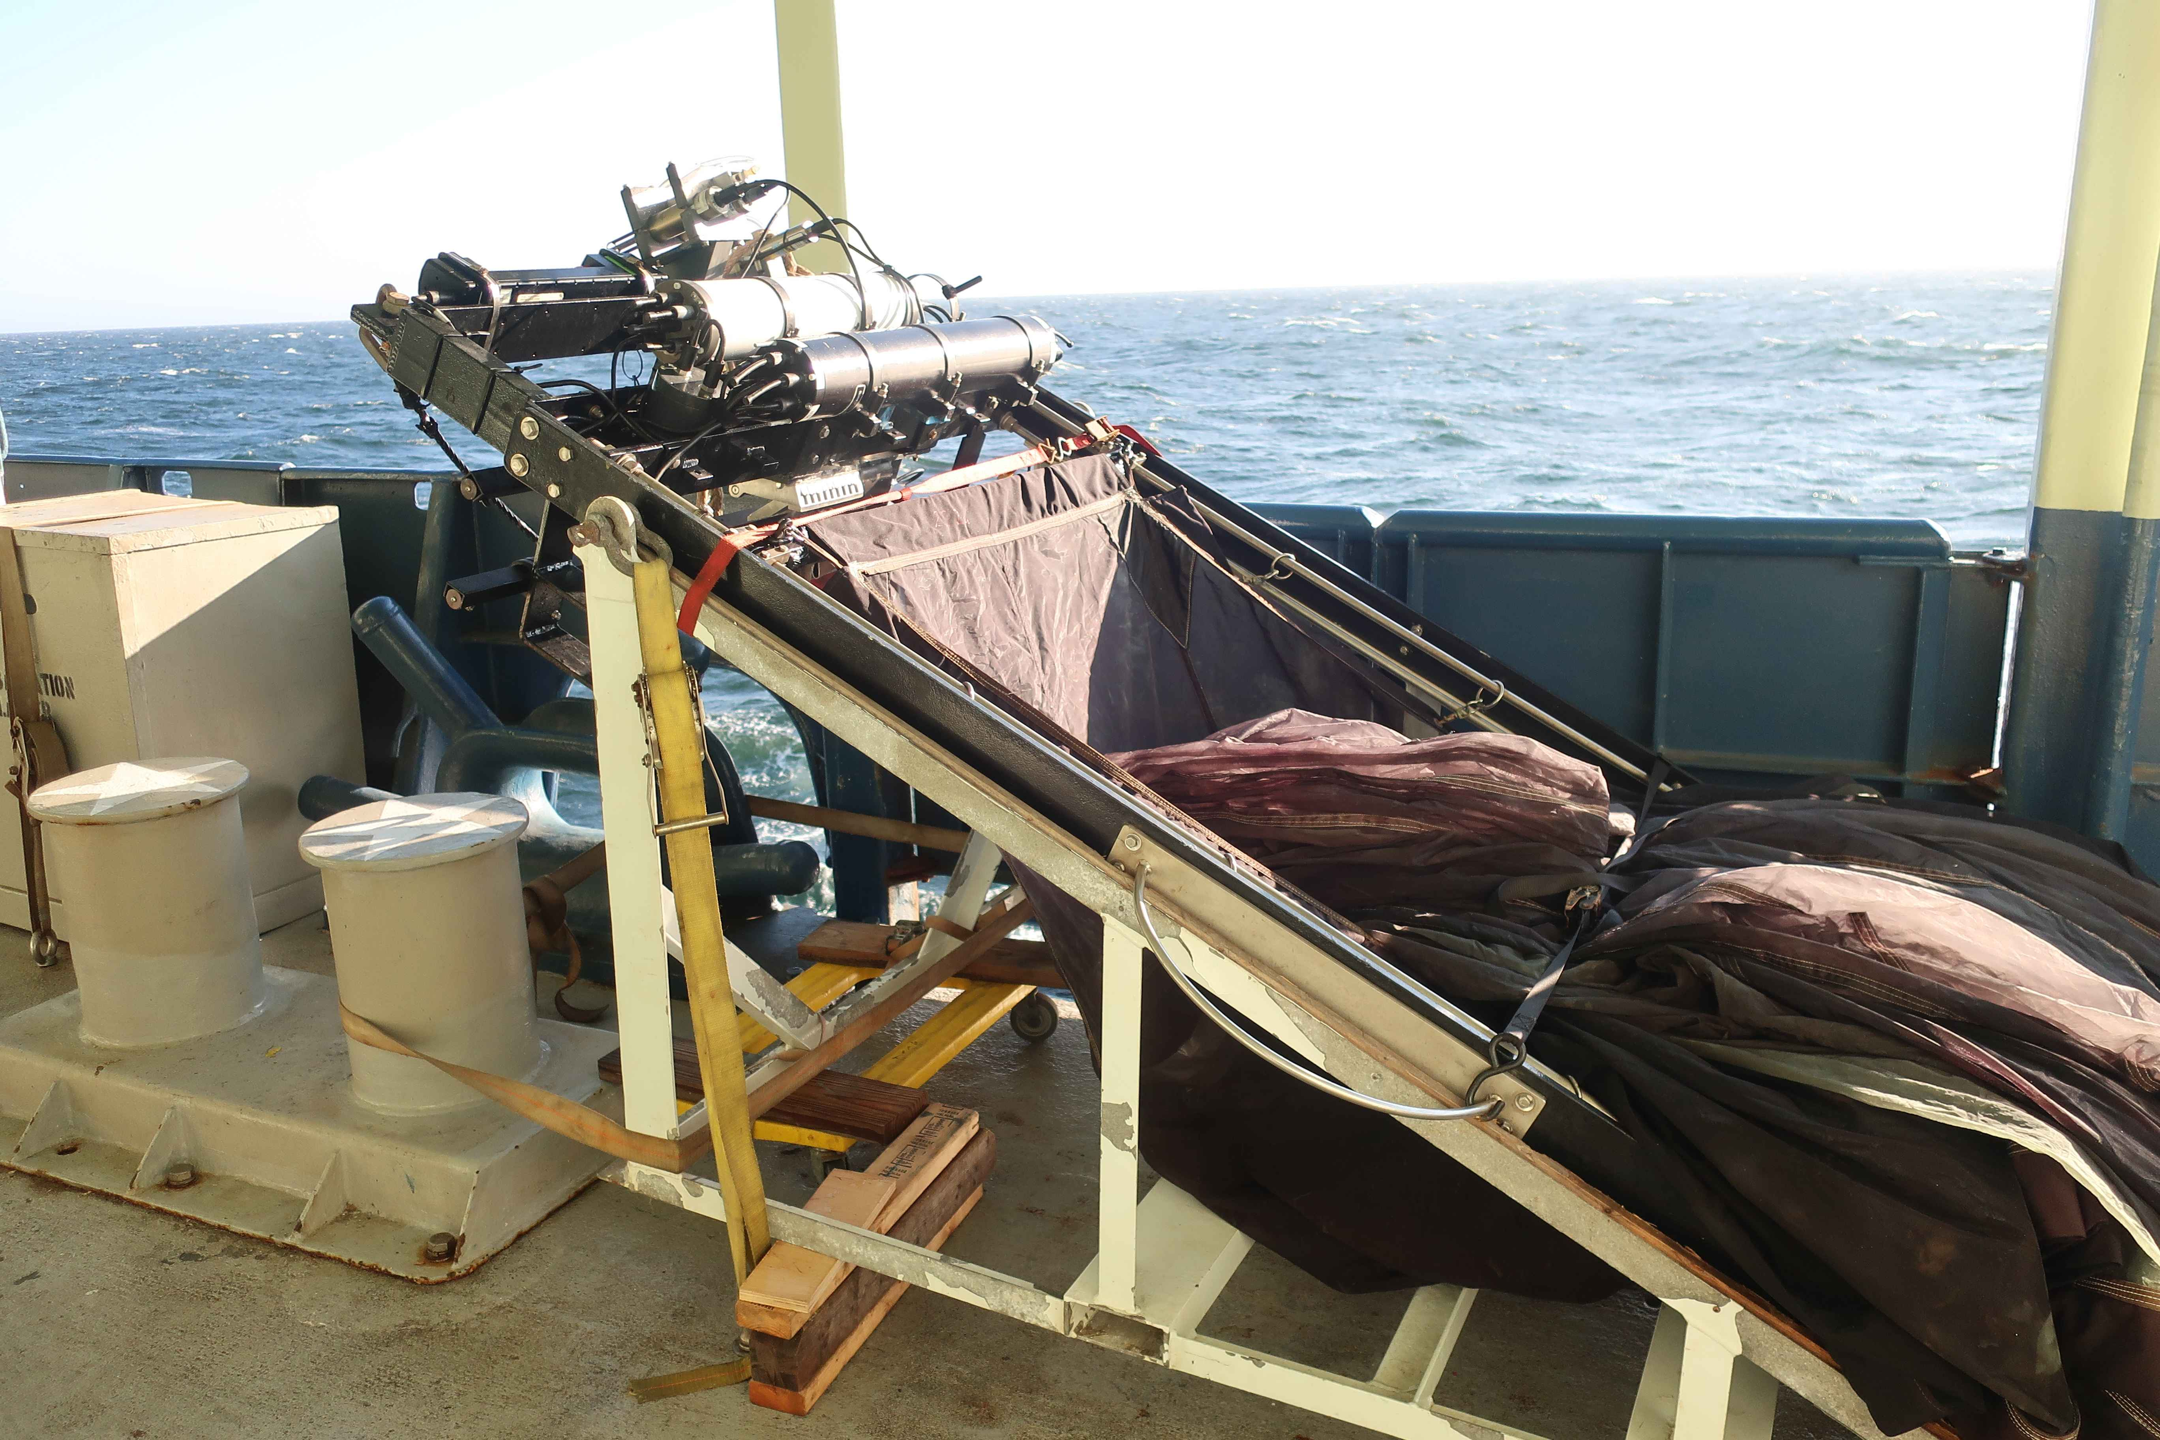
Plankton NET Interface for Mocness Systems – Next Steps
Carl Mattson, Research & Development Engineer, Shipboard Technical Support, Scripps Institution of Oceanography

Slide 2
Acknowledgements
Shipboard Technical Support
Carl Mattson
John Calderwood
Research & Development Engineer
Sr Electronics Technician

Slide 3
Plankton NET Interface for Mocness Systems
Topics:
Recap of the Development of the PKI system
Current Operational Status
Strobe system
Future goals and the next steps

Slide 4
Plankton Net Interface – What is it?
The Plankton Net Interface allows the ability to use the Seabird SBE9Plus CTD on
Mocness Systems in place of the original CTD and controller unit.
• Acquires and stores Real-time data from the CTD.
• Controls the NET motor and trips the Plankton nets.
• Acquires and stores Flow Meter data and computes volumes.
• Acquires and stores data from the GPS via RS232 or UDP ports.
• Displays data on strip charts and XY plots.
• Acquired data can be played back and displayed.
• Data is stored in the Seabird data format.

Slide 5
PKI SYSTEM BLOCK DIAGRAM
SEA CABLE
NET
PLANKTON
INTERFACE
SEABIRD
SBE9Plus
CTD
MOTOR 1
TEMPERATURE
FLOWMETER 1
CONDUCTIVITY
MODEM
MODEM
RSP 1
NET ANGLE UNIT
AUX1
MOTOR 2
TRANSMISSOMETER
AUX2
FLOWMETER 2
FLUOROMETER
AUX3
OXYGEN
AUX4
RSP 2

Slide 6
Development Timeline
The idea of being able to use a SBE9Plus CTD on the Mocness has been
around for many years.
In 2015, development began on the software and hardware. An early prototype was completed.
April 2016 - The prototype was tested on a cruise on the R/V Oceanus and used again on the R/V Sikuliaq in January/February 2017. The reports that came back from these cruises were positive overall but reported that there were a few issues with the software. The detailed information that they sent proved instrumental in helping to fix these issues.

Slide 7
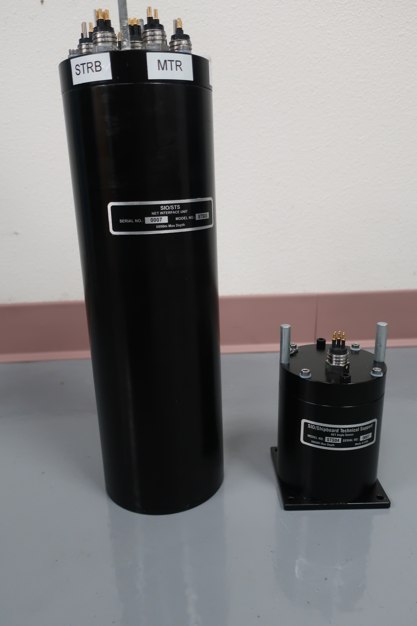
Early Development Timeline
In 2017, NSF granted funding to allow for the
fabrication of new PKI and net angle units to be
distributed to six UNOLS institutions.
The cases were made out of 7075 Aluminum
And Black anodized.
These units were built and shipped out in late
2017 and early 2018.
PKI Unit
15.75” L
5.0” W
16.0 Lbs
Net Angle Unit
5.0” L
4.0” W
5.5 Lbs

Slide 8
Case Pitting Problems
Throughout 2018, these PKI systems were used successfully on many Mocness deployments. The institutions that received them had reported back that the PKI unit that they received was working very well and appreciated how improved this system was over the original one.
However, in early 2019 the technicians at Oregon State had noticed that excessive pitting and blisters had formed on the outside of the pressure housings of both the PKI unit and the NET Angle sensor.
This pitting problem was reported back to STS on February 2019. Pitting was subsequently found on some of the units sent to other institutions. Shortly after receiving these reports STS sent out a recall notice on February 8, 2019 to all UNOLS Mocness users to return these units back to SIO/STS for evaluation/repair as soon as possible.

Slide 9
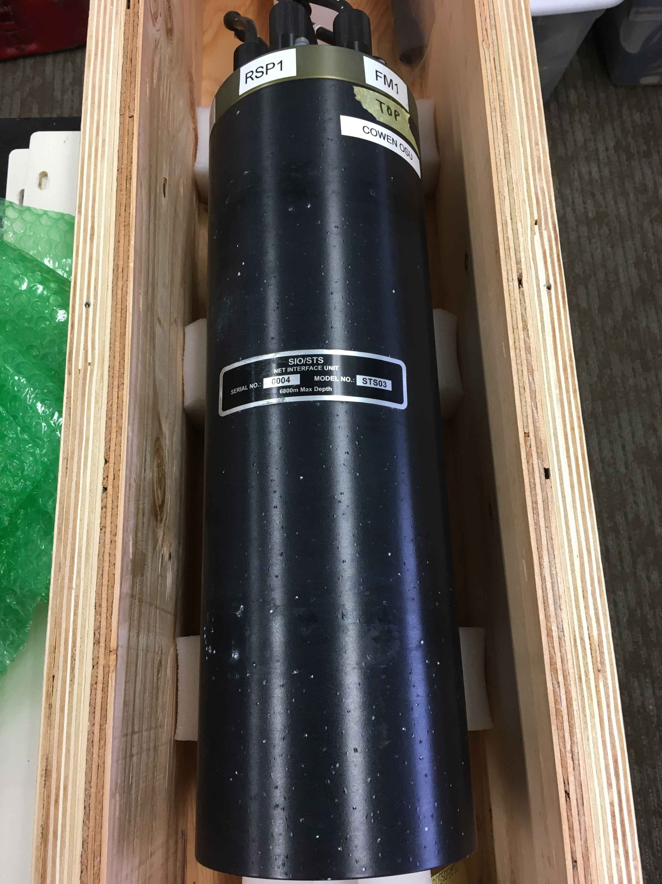
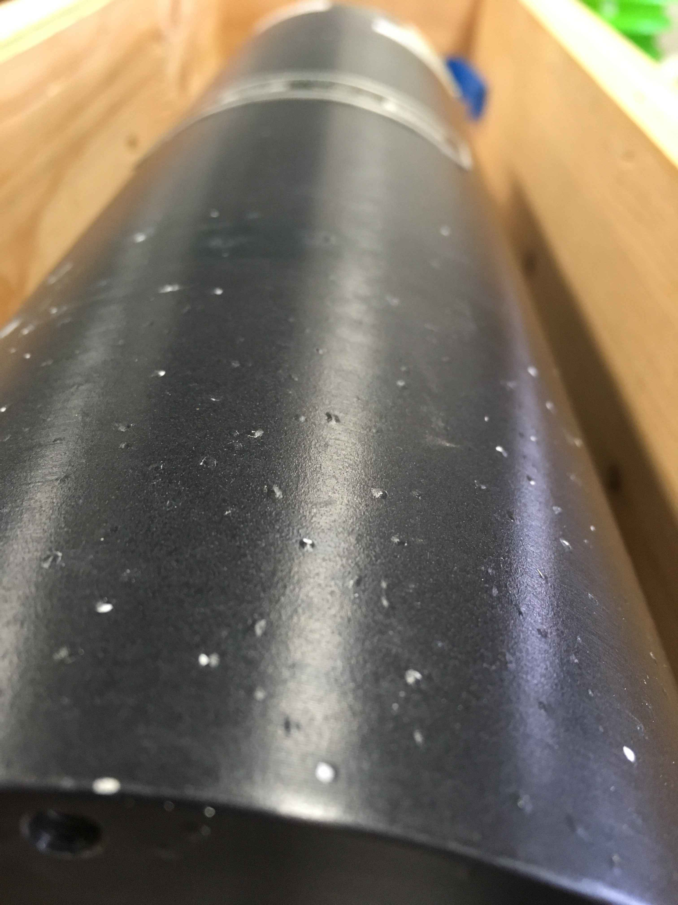
Pitting Problems

Slide 10
Pitting Problems
The SIO MPL machine shop investigated the cause of the pitting and suggested that there may have been something wrong with the batch of 7075 material that the cases were made from. 7075 is an aluminum/zinc alloy and if the zinc component had migrated to the surface due to either faulty material or improper heat treating or anodizing then it could result in pitting.
Using a new batch of material the SIO machine shop built new housings to replace the ones that were not repairable. These housings were completed in about five months.
All PKI Units and NET Angle units have been returned to their owners by the end of June 2019.

Slide 11
Current Status
Two more sets of PKI and Net Angle units were built in 2019. There are currently a total of 8 sets of production units at this time not counting the original prototype.
1. United States Antarctic Program
2. University of Alaska Fairbanks R/V Sikuliaq
3. Bermuda Institute of Ocean Sciences
4. Oregon State University
5. University of Rhode Island
6. University of Hawaii
7. Scripps Institution of Oceanography
8. University of Miami

Slide 12
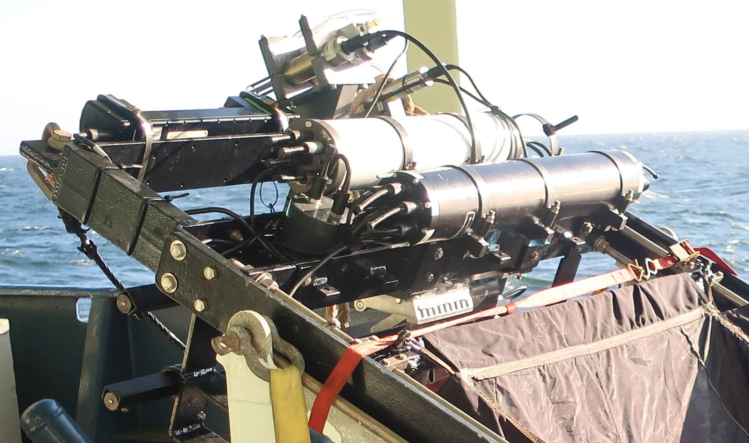
Current Status
The SIO 1M2 10 NET mocness with the PKI Unit was recently used in August 2019 on the R/V Atlantis. The cruise was part of the CCE-LTER Network. (California Current Ecosystem - Long Term Ecological Research).
CTD
STROBE UNIT
NET ANGLE SENSOR
PKI UNIT
24 Mocness tows were completed using the PKI unit. All Nets were successfully tripped and confirmed on 23 of the tows. On the tow that did not trip/confirm it was due to improper Net preparation prior to the tow.

Slide 13
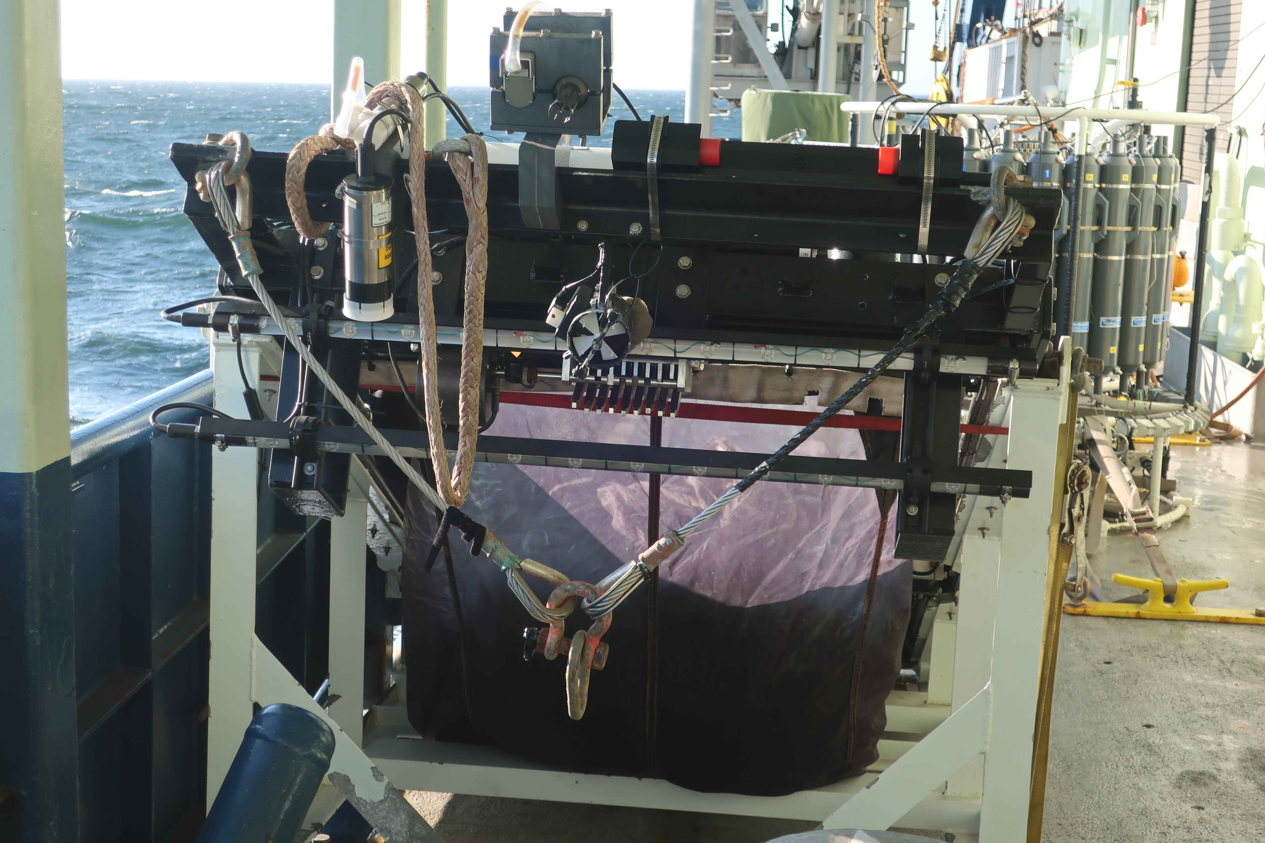
Current Status
Transmissometer
Oxygen
Fluorometer
STROBE LED BAR #1
STROBE LED BAR #2

Slide 14
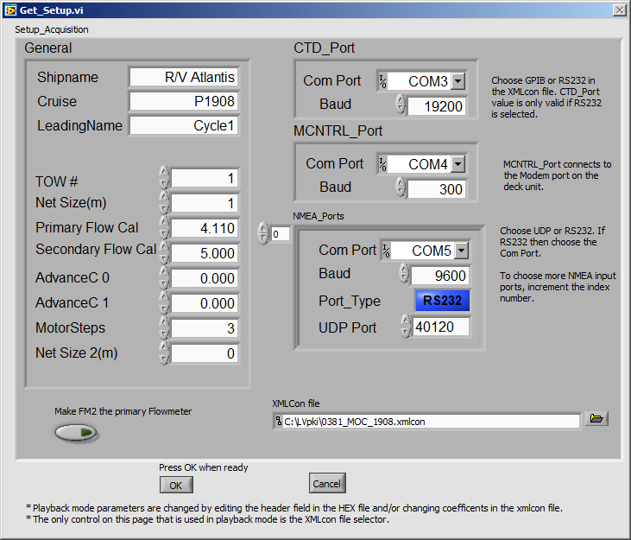
Screenshot 1 – Setup Page

Slide 15
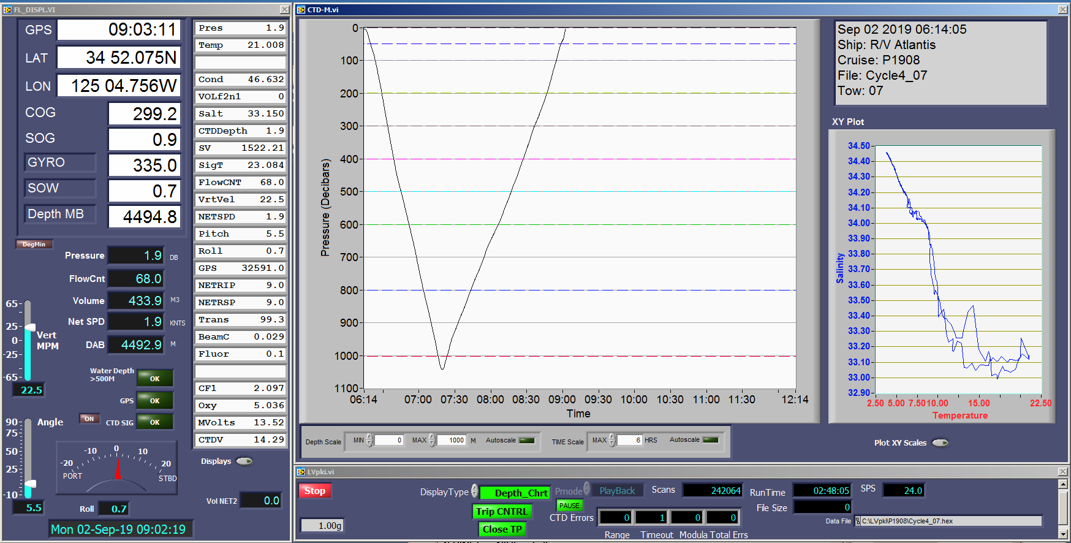
Screenshot 2 – Mocness Depth Plot

Slide 16
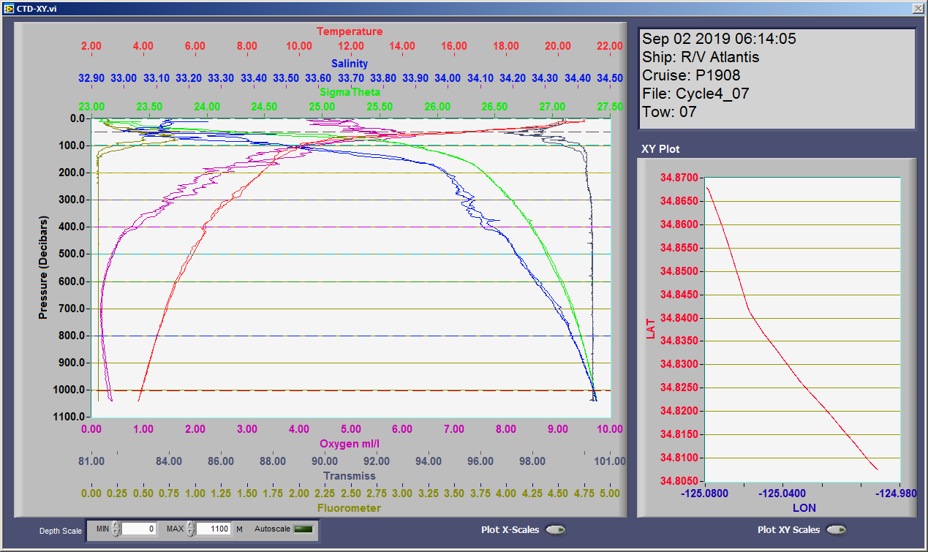
Screenshot 3 Multi XY Plot

Slide 17
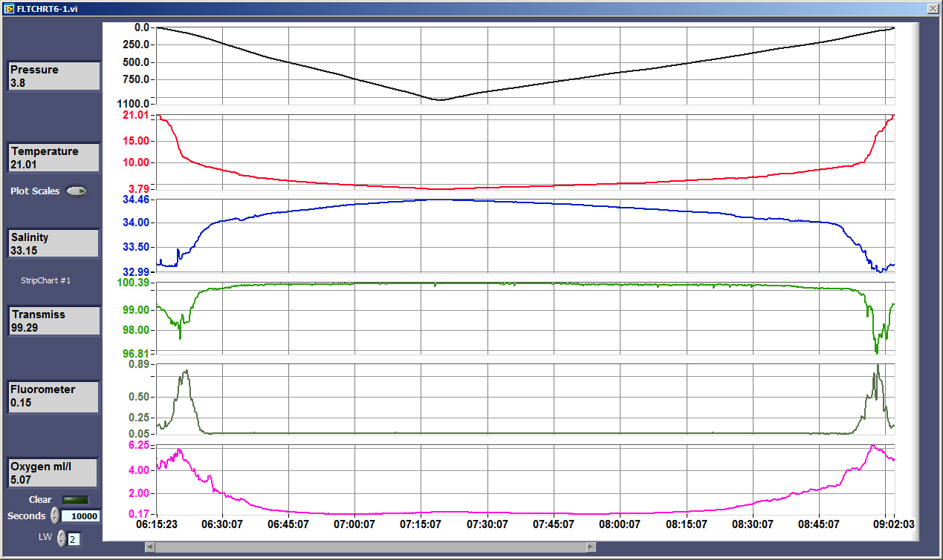
Screenshot 4 - StripCharts

Slide 18
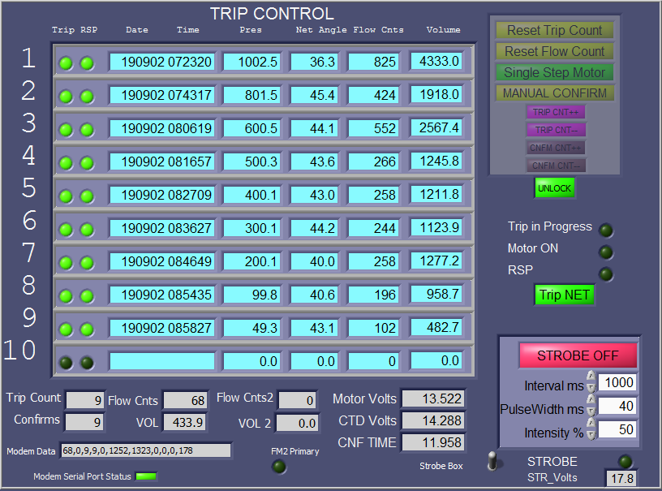
Screenshot 5 – NET Trip Page

Slide 19
STROBE UNIT
In 1993 Doug Sameoto and Alex Herman of the Bedford Institute of Oceanography published their work on strobe-related increases in euphausiid catches (Sameoto et al 1993, Herman et al 1993).
Dr Peter Wiebe of the Woods Hole Oceanographic Institution had developed a strobe system for the Mocness (Wiebe et al 2013).
In 2017 Dr Mark Ohman of the Scripps Institution of Oceanography had acquired funding to purchase a similar strobe system. However, he was unable to get a working system in time to meet his schedule so he contacted STS to see if we could design and build a new strobe system in the required time frame.
In 2018/2019 the STS strobe system was built and designed to either interface through the PKI unit or to function independently as a stand alone system.

Slide 20
STROBE UNIT
Overall size and shape:
2 LED BARS 1M long mounted above the top of the net opening directly in front of the MOCNESS
Number of LEDS:
Each Light bar has 12 LED sets, each set with 3 adjacent LEDS. Total of 36LEDs per Light bar.
Wavelength range
Peak LED output approximately 505 nm
Strobe interval
100 -10,000 ms
Strobe pulse width
2 - 100 ms.
Software controls
On/Off, Flash Interval, Pulse width, Flash intensity (ranging from 0 to 100%)

Slide 21
STROBE UNIT
During the August 2019 CCE-LTER cruise on the Atlantis the strobe was turned on for 9 tows to 1000M depth. This is the first cruise that this new strobe unit was used and it worked flawlessly throughout the cruise. During night tows the strobe was clearly visible to 30 Meters below the surface. During this cruise the strobe brightness was set at 50% with a pulse width of 40ms at a 1HZ pulse rate.
Dr. Mark Ohman said that while it is too early to report on the effects that the strobe had in regards to the amount of bio-volume as compared to when the strobe is off he did say that on several tows with the strobe on that they were able to capture three vampire squid. No vampire squid were captured when the strobe was off. The strobe was turned on for 9 tows and it was turned off for 15 tows.

Slide 22
Future goals and the next steps
Now that the PKI units have been completed and used successfully we can consider what we would like to accomplish to ensure future support for Mocness systems.
Some topics for discussion:
1. Flowmeters – What alternatives are available?
2. Motors
3. Response switch reliability issues.
4. Providing for backup systems.

Slide 23
Flowmeters
Bill Fanning had recently reported that Mocness Flowmeters are still available and can still be purchased from the manufacturer for $2750 EA.
Possible Alternative sources:
TSK Tsurumi-Seiki Co.,ltd - (Approximate price: $1250-$1550)
This is the same flowmeter but does not have the magnetic reed switch interface. This would need to be added after purchase.
General Oceanics Model 2031H (Approximate price: $652)
This flowmeter has a hall effect sensor and needs a 3-wire connection. It is possible to accommodate it in the PKI unit.
Valeport Model 001 (Approximate price: $2900)
This flowmeter does have a magnetic reed switch interface.

Slide 24
Mocness Motors
Mocness Motor units can probably be purchased from the manufacturer. Scott Ferguson had reported that he did try to get a quote but received no response. Scott searched around and found that the internal stepper motor is not available from anyplace else.
One of the weaknesses of this motor is that it has very little torque. Occasionally when the tension on the net lanyards becomes a bit too tight then the motor cannot turn.
This particular motor has a two wire connection that is not found on any standard stepper motor that is in use today. One alternative is to replace the motor with a standard bipolar stepper and install a stepper interface inside the PKI unit. The bipolar steppers have plenty of torque. In addition it is possible to incorporate an encoder onto the stepper in order to send back the motor position information back to the ship. This would indicate a positive confirmation that the motor turned.

Slide 25
RSP Switch
The RSP switch configuration has historically been a weak point as it did not always confirm a net trip even in cases where the net did trip.
However, in the past couple of years, many users had reported that since they have started using the PKI system then they have had fewer issues with getting a confirmation signal after a net trip.
In cases when the RSP does not confirm then it is most often due to the RSP switch assembly slipping up or down on the support rod. This can be corrected by tightening the securing bolts as tight as possible to reduce slippage problems. The switch should be located as high as possible on the bar and still able to confirm all nets. A slight downward angle on the switch lever has also been found to be helpful.
At this time we are still open to new ideas to improve the ability to confirm net trips.

Slide 26
CONCLUSION
The STS Plankton Net Interface system has evolved over the past few years to one that can reliably accommodate the use of a seabird CTD on a Mocness system. We had a few hurdles with getting the pressure housing pitting issue resolved. In addition, the software had a few bugs in the beginning but thanks to the shipboard technicians who reported back on these issues the program was improved substantially and is now working very well. We can now move on to continue improving other components of the Mocness system such as the motor, flowmeter and confirmation sensor.

Slide 27
For more information Contact
Carl Mattson
cmattson@ucsd.edu
Latest software and documentation:
ftp://somts.ucsd.edu/users/cmattson/Mocness/LVpki/
Sources Cited:
Sameoto, D. D., N. Cochrane, and A. Herman 1993. Convergence of acoustic, optical, and net-catch estimates of euphausiid abundance: use of artificial light to reduce net avoidance. Can. J. Fish. Aquat. Sci. 50: 334-346.
Herman, A.W., Cochrane, N.A., Sameoto, D.D., 1993. Detection and abundance estimation of euphausiids using an optical plankton counter. Marine Ecology Progress Series 94, 165-173
2013 Wiebe, P.H., G.L. Lawson, A.C. Lavery, N.J. Copley, E. Horgan, and A. Bradley. 2013. Improved agreement of net and acoustical methods for surveying euphausiids by mitigating avoidance using a net based LED strobe light system. ICES Journal of Marine Science. (2013) 70(3): 650-664 doi:10.1093 /icesjms/fst005.

